Slide 1

Web Development 1
Lecture 6b
Styling links

Slide 2
Context: Navbars are LISTs of LINKs
At the core of navbars are list items containing links, e.g.
<nav> <ul> <li><a href="index.html">home</a></li> <li><a href="about.html">about</a></li> <li><a href="contact.html">contact</a></li> </ul> </nav>
HMTL

Slide 3
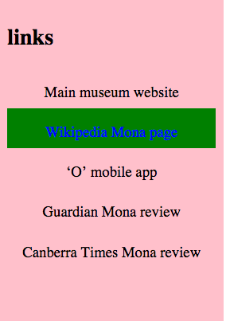
Vertical navbar – e.g. Mona museum

Slide 4
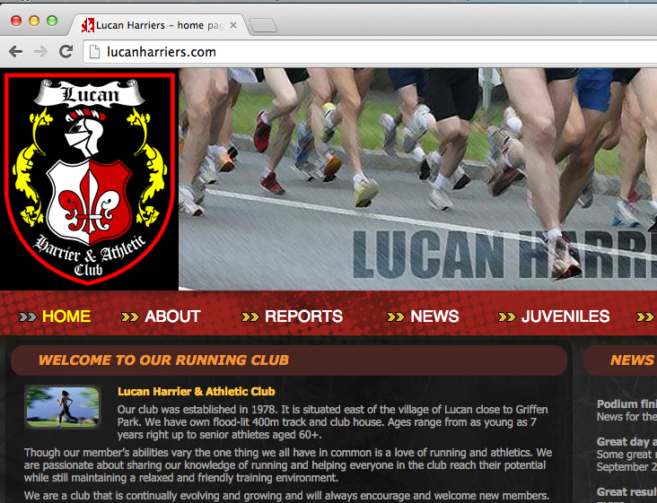
Horizontal navbar – e.g. Lucan Harriers.com

Slide 5
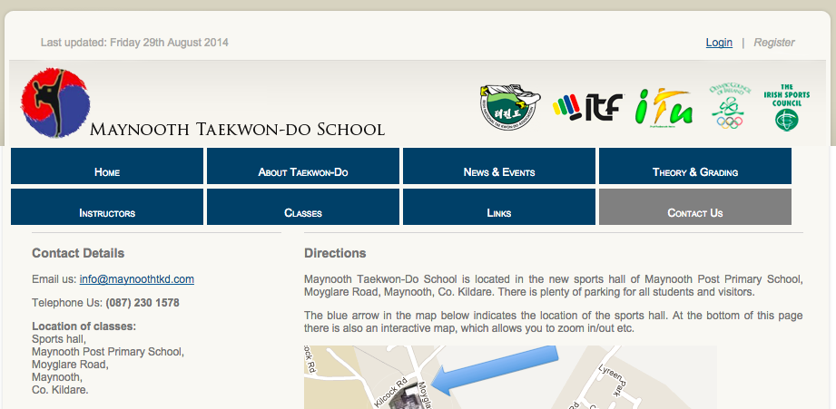
Horizonal navbar – 2 rows e.g. MaynoothTKD.com

Slide 6
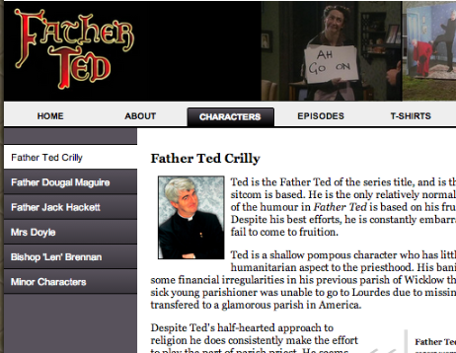
2 navbars – in the Father Ted site can you tell which page / section we are visiting?

Slide 7
Learn to remove default styling for links (underlines and blue/purple)

Slide 8
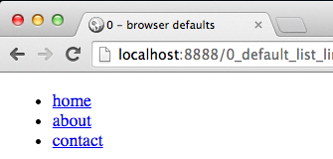
DEFAULT styling for UL list of links
<nav> <ul> <li><a href="index.html">home</a></li> <li><a href="about.html">about</a></li> <li><a href="contact.html">contact</a></li> </ul> </nav>
HMTL

Slide 9
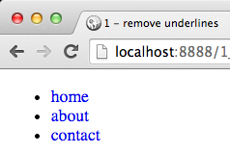
How can we remove underlines for links?
CSS property text-decoration determines whether text is underlined or not:
text-decoration: none
text-decoration: underline
Almost all browsers underline links by default
Let’s turn that off:
a {
text-decoration: none;
}
CSS

Slide 10
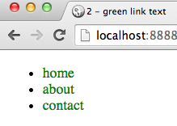
How can we remove blue/purple color?
CSS property color for text color
Almost all browsers:
Color unvisited links BLUE
Color visited links (in browser history) PURPLE
Let’s make ALL links (regardless of visited status) green
a {
color: green;
text-decoration: none;
}
NOTE: Matt prefers all links to have same style – whether visited or not … the above ‘a’ rule does this ☺

Slide 11
Mouse rollover effect
a:hover
Example of CSS ‘pseudo-class’

Slide 12

Let’s add a yellow background for mouse rollover of navbar links
CSS provides a ‘pseudoclass’ :hover
Which allows a style to be applied to links only when the mouse is hovering over them
Let’s set background-color to yellow when mouse is hovering
a { ... as before ... }
a:hover {
background-color: yellow;
}
CSS

Slide 13
Use CLASS to style current page

Slide 14

Assume we are coding page about.html
We want to highlight the ‘about’ link to tell user we are on that page
Let’s use a ‘class’ attribute in the ‘a’ element for about:
<nav> <ul> <li><a href="index.html">home</a></li> <li><a href="about.html” class="current_page">about</a></li> <li><a href="contact.html">contact</a></li> </ul> </nav>
HMTL

Slide 15
Add a ‘class’ attribute to element ‘a’ for the about link, and CSS style for .current_page
<nav> <ul> <li><a href="index.html">home</a></li> <li><a href="about.html” class="current_page">about</a></li> <li><a href="contact.html">contact</a></li> </ul> </nav>
HMTL
a { ... as before ... }
a:hover {... as before ...}
a.current_page {
color: red;
text-decoration: underline;
}
CSS

Slide 16
Summary and Conclusions

Slide 17
Summary and Conclusions
To style unvisited/visited links
CSS create style for a {}
To add a mouse over effect
CSS create style for a:hover {}
To indicate ‘current page’:
HTML add class=”current_page” to link for current page
CSS create style for .current_page {}
ORDER of CSS rules is important – always this order:
CSS rule for a
CSS rule for a:hover
CSS rule for a.current_page
Stick to this sequence and styling links is very straightforward

Slide 18
What is .current_page rule before :hover
Then current page link will be changed when mouse hovering over it
Since both :hover and .class have the same specificity (priority) in CSS
If 2 rules have the same specificity, then the last one read by the browser will take preference
Learn more about specificity at:
http://css-tricks.com/specifics-on-css-specificity/
http://www.smashingmagazine.com/2007/07/27/css-specificity-things-you-should-know/
http://www.impressivewebs.com/css-specificity-irrelevant/
http://www.w3.org/TR/CSS2/cascade.html#specificity
Keegan Streets interactive specificity calculator …
http://specificity.keegan.st/

Slide 19
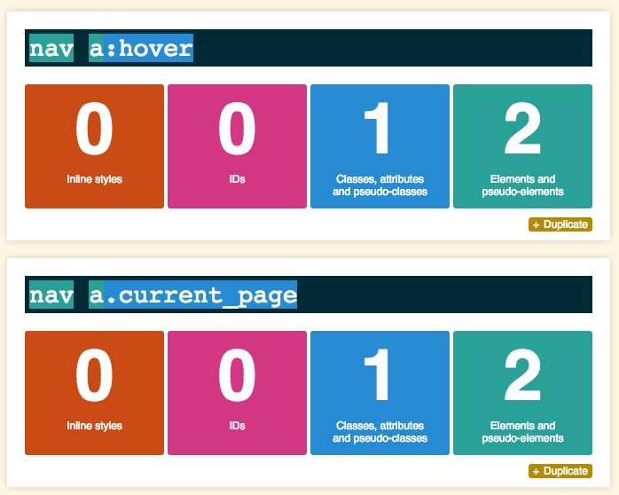
Keegan Streets interactive specificity calculator … http://specificity.keegan.st/

